Slide 1
Home rental system
Team:
1. RITESH JANGONDA Patil
2NIKHIL DILIP KADAPURE
3.ramaksha sonopant Kulkarni
4. ATHARV PATIL

Slide 2
Introduction
A home rental system is a software application that helps landlords and tenants manage their rental properties.
It provides a platform for landlords to list their properties and for tenants to search for available properties.
The system also facilitates communication between landlords and tenants, allowing them to exchange messages and document
Regardless of the specific system used, a home rental system can help simplify the process of renting and managing properties, making it easier for both landlords and tenants to achieve their goals.

Slide 3
Entities and attributes
Department
attributes(Department ID, Department name)
Employee(Employee Id, Mobile Number, name, AadharCard, Salary, Department ID )
Landlord(Landlord ID, Name, Mobile Number, Email , AadharCard No)
Tenant(Tenant ID, Name, Mobile Number, Email , AadharCard)
Property(Property_ID, Landlord_ID,Location, Property_Area_Sqft ,BHK ,Rent ,Deposit , Furnished)
Rent Agreement(RentAgreement_ID, Property_ID, Tenant_ID, MonthsOfLease, Rent_Amount)

Slide 4
Table structure

Slide 5
department
CREATE TABLE Department (
Department_ID INT PRIMARY KEY,
Department_Name VARCHAR(20) UNIQUE NOT NULL
);

Slide 6
employee
CREATE TABLE Employee (
Employee_ID INT PRIMARY KEY auto_increment,
Name VARCHAR(30),
Mobile_Number VARCHAR(10),
AadharCard_ID VARCHAR(20),
Salary INT,
Department_ID INT,
FOREIGN KEY (Department_ID) REFERENCES Department(Department_ID)
);

Slide 7
landlord
CREATE TABLE Landlord (
Landlord_ID INT PRIMARY KEY auto_increment,
Name VARCHAR(30) NOT NULL,
Mobile_Number VARCHAR(10) NOT NULL,
Email VARCHAR(30),
AadharCard_No VARCHAR(20)
);

Slide 8
Tenant
CREATE TABLE Tenant (
Tenant_ID INT PRIMARY KEY auto_increment,
Name VARCHAR(30),
Mobile_Number VARCHAR(10),
Email VARCHAR(30),
AadharCard_No VARCHAR(20)
);

Slide 9
Property
CREATE TABLE Property (
Property_ID INT PRIMARY KEY auto_increment,
Landlord_ID INT,
Location VARCHAR(30) NOT NULL,
Property_Area_Sqft INT,
BHK INT NOT NULL,
Rent INT NOT NULL,
Deposit INT,
Furnished VARCHAR(3) NOT NULL,
FOREIGN KEY (Landlord_ID) REFERENCES Landlord(Landlord_ID)
);

Slide 10
Rent Agreement
CREATE TABLE RentAgreement (
RentAgreement_ID INT PRIMARY KEY auto_increment,
Property_ID INT,
Tenant_ID INT,
MonthsOfLease INT,
Rent_Amount INT,
FOREIGN KEY (Property_ID) REFERENCES Property(Property_ID),
FOREIGN KEY (Tenant_ID) REFERENCES Tenant(Tenant_ID)
);

Slide 11
populating records

Slide 12
department
INSERT INTO Department (Department_ID, Department_Name)
VALUES
(1, 'Engineering'),
(2, 'Finance'),
(3, 'Human Resources'),
(4, 'Sales'),
(5, 'Marketing'),
(6, 'R and D'),
(7, 'Customer Support'),
(8, 'IT Services'),
(9, 'Legal'),
(10, 'Administration');

Slide 13
employee
INSERT INTO Employee (Name, Mobile_Number, AadharCard_ID, Salary, Department_ID)
VALUES
('Shrinivas Jadhav', '9876543210', '1234-5678-9012', 150000, 1),
('Dhaneshree Rangole', '8765432109', '2345-6789-0123', 60000, 2),
('Amit Kumar', '7654321098', '3456-7890-1234', 45000, 1),
('Priya Singh', '6543210987', '4567-8901-2345', 55000, 3),
('Rajesh Patel', '5432109876', '5678-9012-3456', 70000, 2),
('Neha Sharma', '4321098765', '6789-0123-4567', 48000, 3),
('Vikram Singh', '3210987654', '7890-1234-5678', 52000, 1),
('Sonia Verma', '2109876543', '8901-2345-6789', 63000, 2),
('Rahul Gupta', '1098765432', '9012-3456-7890', 58000, 3),
('Anita Joshi', '9988776655', '1234-5678-9012', 67000, 1);

Slide 14
Landlord
INSERT INTO Landlord (Name, Mobile_Number, Email, AadharCard_No)
VALUES
('Rajesh Kumar', '9876543210', 'rajesh@example.com', '1234-5678-9012'),
('Priya Sharma', '8765432109', 'priya@example.com', '2345-6789-0123'),
('Amit Singh', '7654321098', 'amit@example.com', '3456-7890-1234'),
('Sonia Verma', '6543210987', 'sonia@example.com', '4567-8901-2345'),
('Rahul Gupta', '5432109876', 'rahul@example.com', '5678-9012-3456'),
('Anita Joshi', '4321098765', 'anita@example.com', '6789-0123-4567'),
('Vikram Sharma', '3210987654', 'vikram@example.com', '7890-1234-5678'),
('Neha Patel', '2109876543', 'neha@example.com', '8901-2345-6789'),
('Ramesh Yadav', '1098765432', 'ramesh@example.com', '9012-3456-7890'),
('Pooja Gupta', '9988776655', 'pooja@example.com', '1234-5678-9012');

Slide 15
Tenant
INSERT INTO Tenant (Name, Mobile_Number, Email, AadharCard_No)
VALUES
('Rahul Kumar', '9876543210', 'rahul@example.com', '1234-5678-9012'),
('Suman Verma', '8765432109', 'suman@example.com', '2345-6789-0123'),
('Anjali Singh', '7654321098', 'anjali@example.com', '3456-7890-1234'),
('Arjun Sharma', '6543210987', 'arjun@example.com', '4567-8901-2345'),
('Meena Yadav', '5432109876', 'meena@example.com', '5678-9012-3456'),
('Vijay Patel', '4321098765', 'vijay@example.com', '6789-0123-4567'),
('Priya Sharma', '3210987654', 'priya@example.com', '7890-1234-5678'),
('Rajat Yadav', '2109876543', 'rajat@example.com', '8901-2345-6789'),
('Neha Gupta', '1098765432', 'neha@example.com', '9012-3456-7890'),
('Pooja Joshi', '9988776655', 'pooja@example.com', '1234-5678-9012');

Slide 16
Property
INSERT INTO Property (Landlord_ID, Location, Property_Area_Sqft, BHK, Rent, Deposit, Furnished)
VALUES
(1, 'Mumbai', 1500, 2, 18000, 20000, 'Yes'),
(2, 'Delhi', 1480, 1, 12000, 15000, 'No'),
(3, 'Bangalore', 1520, 3, 22000, 25000, 'Yes'),
(4, 'Chennai', 1475, 2, 17000, 22000, 'No'),
(5, 'Kolkata', 1490, 1, 13000, 16000, 'Yes'),
(6, 'Hyderabad', 1550, 4, 25000, 30000, 'Yes'),
(7, 'Pune', 1530, 3, 20000, 27000, 'No'),
(8, 'Ahmedabad', 1485, 2, 16000, 19000, 'Yes'),
(9, 'Jaipur', 1495, 1, 10000, 12000, 'No'),
(10, 'Lucknow', 1478, 2, 16000, 20000, 'Yes');

Slide 17
RentAgreement
INSERT INTO RentAgreement (Property_ID, Tenant_ID, MonthsOfLease, Rent_Amount)
VALUES
(1, 1, 12, (SELECT Rent FROM Property WHERE Property_ID = 1)),
(2, 2, 6, (SELECT Rent FROM Property WHERE Property_ID = 2)),
(3, 3, 24, (SELECT Rent FROM Property WHERE Property_ID = 3)),
(4, 4, 18, (SELECT Rent FROM Property WHERE Property_ID = 4)),
(5, 5, 9, (SELECT Rent FROM Property WHERE Property_ID = 5)),
(6, 6, 36, (SELECT Rent FROM Property WHERE Property_ID = 6)),
(7, 7, 30, (SELECT Rent FROM Property WHERE Property_ID = 7)),
(8, 8, 15, (SELECT Rent FROM Property WHERE Property_ID = 8)),
(9, 9, 12, (SELECT Rent FROM Property WHERE Property_ID = 9)),
(10, 10, 18, (SELECT Rent FROM Property WHERE Property_ID = 10));

Slide 18
e.r.d. diagram

Slide 19
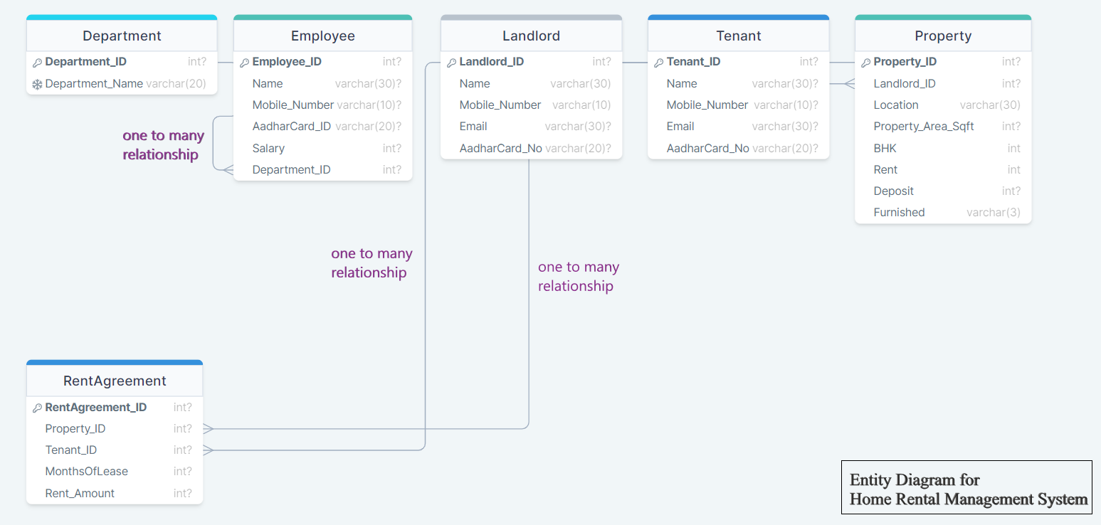

Slide 20
clearing record

Slide 21
Delete clause
DELETE FROM RentAgreement;
DELETE FROM Property;
DELETE FROM Employee;
DELETE FROM Department;
DELETE FROM Tenant;
DELETE FROM Landlord;

Slide 22
Drop tables
drop table rentagreement;
drop table property;
drop table employee;
drop table department;
drop table tenant;
drop table landlord;

Slide 23
stored procedures

Slide 24
Procedure to add property by landlord
DELIMITER //
CREATE PROCEDURE AddProperty (
IN p_Landlord_ID INT,
IN p_Location VARCHAR(30),
IN p_Property_Area_Sqft INT,
IN p_BHK INT,
IN p_Rent INT,
IN p_Deposit INT,
IN p_Furnished VARCHAR(3)
)

Slide 25
BEGIN VALUES (
INSERT INTO Property ( p_Landlord_ID,
Landlord_ID, p_Location,
Location, p_Property_Area_Sqft,
Property_Area_Sqft, p_BHK,
BHK, p_Rent,
Rent, p_Deposit,
Deposit, p_Furnished
Furnished );
) END //
DELIMITER ;

Slide 26
Procedure to add tenant details by tenant
DELIMITER //
CREATE PROCEDURE AddTenant(
IN in_name VARCHAR(30),
IN in_mobile_number VARCHAR(10),
IN in_email VARCHAR(30),
IN in_aadhar_card_no VARCHAR(20)
)
BEGIN
INSERT INTO Tenant (Name, Mobile_Number, Email, AadharCard_No)
VALUES (in_name, in_mobile_number, in_email, in_aadhar_card_no);
END //
DELIMITER ;

Slide 27
functions & triggers

Slide 28
Function to get property COUNT by tenant
DELIMITER //
CREATE FUNCTION GetPropertyCount()
RETURNS INT
DETERMINISTIC
BEGIN
DECLARE propertyCount INT;
SELECT COUNT(*) INTO propertyCount
FROM Property; RETURN propertyCount;
END; //
DELIMITER ;

Slide 29
function to get Get Total Rent of Landlord by landlord
DELIMITER // WHERE p.Landlord_ID = LandlordID;
CREATE FUNCTION GetTotalRentByLandlord(LandlordID INT) RETURN TotalRent;
RETURNS INT END //
READS SQL DATA DELIMITER ;
BEGIN select GetTotalRentByLandlord(6);
DECLARE TotalRent INT;
SELECT SUM(ra.Rent_Amount)
INTO TotalRent
FROM rentagreement ra
JOIN property p ON ra.Property_ID = p.Property_ID

Slide 30
trigger
DELIMITER //
CREATE TRIGGER update_rent_agreement
AFTER UPDATE ON Property
FOR EACH ROW
BEGIN
UPDATE RentAgreement
SET Rent_Amount = NEW.Rent
WHERE Property_ID = NEW.Property_ID;
END; // DELIMITER ;

Slide 31
thank you !

